Slide 1
Mobility Workforce Modeling
Update to the Data and Coordination Working Group
September 16, 2025

Slide 2
Moody’s economic modeling, Core Auto output and employment, 2018-2024, 2024-2030, 2030-2036

Slide 3
Moody’s economic modeling for the state of Michigan anticipates a 28.0% increase in output that is associated with a 1.1% increase in employment across Core Auto industries NAICS 3361-3362

Slide 4
Moody’s model for the United States anticipates a 35.7% increase in output associated with a 7.1% increase in employment across Core Auto industries NAICS 3361-3362

Slide 5
U.S. and Michigan Automotive Sales and Production, Historical Trends

Slide 6
Domestic vehicle production has declined significantly since 2015. U.S. vehicle sales have fluctuated but remain near levels seen prior to the pandemic.

Slide 7
Michigan employment in Core Automotive has remained relatively consistent in recent years despite declining domestic vehicle production

Slide 8
Michigan Gross Domestic Product in Vehicle Manufacturing

Slide 9
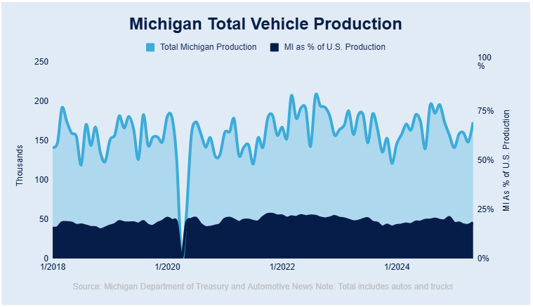
MichAuto Data Interactive shows fluctuation around 150,000 cars and trucks produced each month in Michigan since 2018. Michigan’s share of U.S. vehicle production stands at 18.4% as of Feb-2025.

Slide 10
CAR Automotive Sales and Production Forecasts

Slide 11
Sales forecasts by the Center for Automotive Research model the scenario where BEV and Hybrid vehicle sales exceed 50% of the market by 2030

Slide 12
Michigan vehicle production increases 27.5%, from 1.7 to 2.2 million units per year by 2030

Slide 13
Expansion of electric motor production drives overall engine production in Michigan through 2030

Slide 14
Shares of Electric and Dedicated Hybrid transmission production are projected to increase, as overall transmission production modestly declines in Michigan through 2030

Slide 15
Mobility shares of Michigan Payroll Employment

Slide 16
Broadly defined, Mobility industry employment represents 23.9% of employment in Jan-2000, 18.2% of employment in Dec-2024

Slide 17
OEM employment (Core Auto + Engineering), 11.2% of employment in Jan-2000, 7.6% of employment in Dec-2024

Slide 18
MCDA Data Exploration

Slide 19
Major Occupation Groups, Shares of industry employment across the supply chain

Slide 20
Major Occupation Groups, Shares of industry employment across the supply chain

Slide 21
Core Automotive employment is dominated by production occupations with median annual salaries of around $47k

Slide 22
Detailed Production Occupations within Core Automotive

Slide 23
Detailed Architecture and Engineering Occupations within Core Automotive

Slide 24
Detailed Management Occupations within Core Automotive

Slide 25
Occupational Employment Change by Education, Observed (2021-2024) and Projected (2024-2034)

Slide 26
Within Core Auto (NAICS 3361-3363), most of the recent-year’s employment growth has occurred among occupations typically requiring a Bachelor’s degree or greater

Slide 27
BA+ occupations have also seen an outsized share of growth across the more broadly defined mobility supply chain

Slide 28
The previous slides’ results align with expectations from the BLS Occupational Projections (2024-34), with employment growth centered on higher-skilled occupations. Annual openings remain high among occupations with lower educational requirements due to churn.

Slide 29
Next Steps

Slide 30
Next Steps
Prorating Michigan Mobility Employment (Total Supply Chain) to estimate Auto-related employment shares of connected industries
Meeting with Bureau of Economic Analysis
Suggested Make-Use Tables (National), deducting import shares of commodities by industry
Regional Impact Modeling (RIMS II), as an alternative
Similar exploration with a Lightcast Make-use table
Action: Follow up with CAR to discuss methodology
Deeper dive into occupations across the mobility supply chain
Linking to U.S. / Michigan Occupational Employment Projections
Assessing Job Openings, Skills, by Occupation
Developing the near-term forecast model to incorporate CAR’s production forecasts

